Slide 1
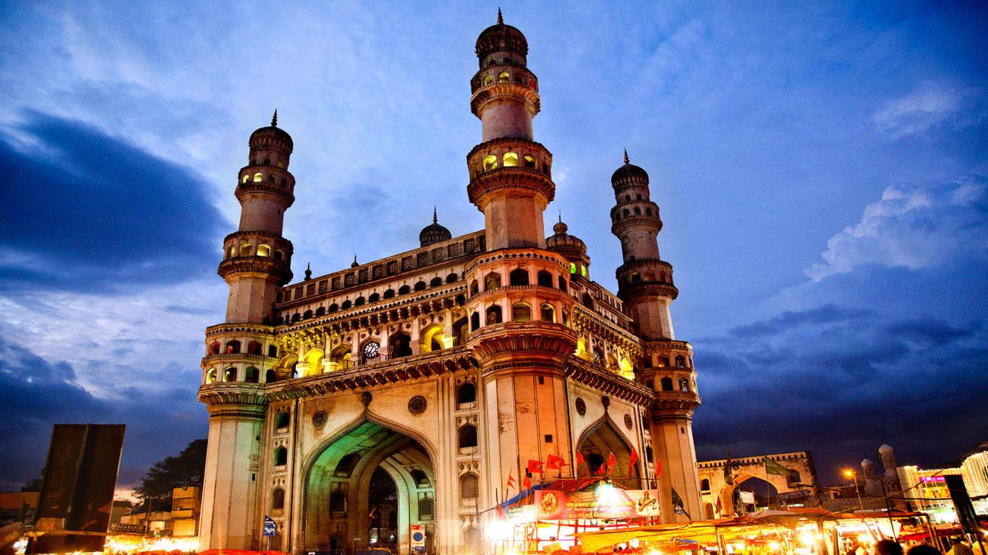

Provide Insights to Telangana Government Tourism Department
CREATED BY :-
PURVI MAJOKA

Slide 2
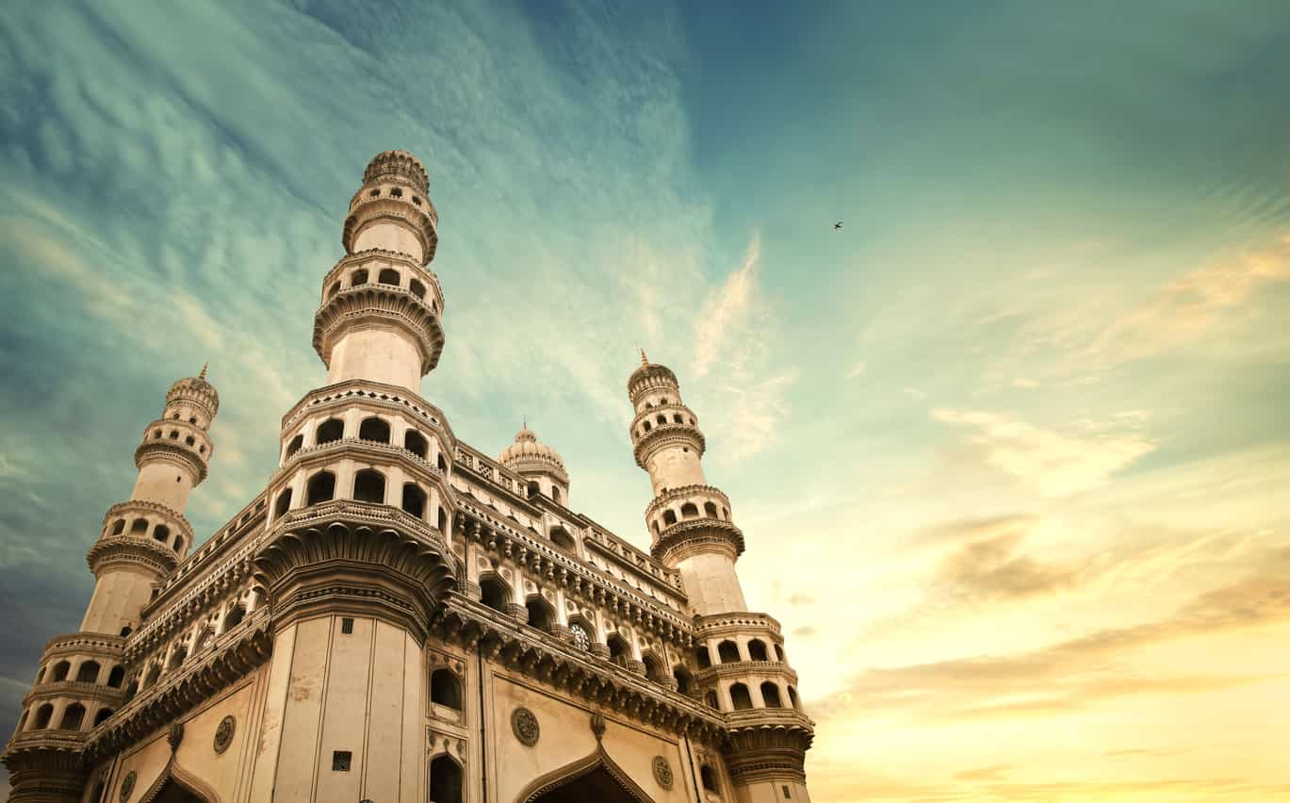
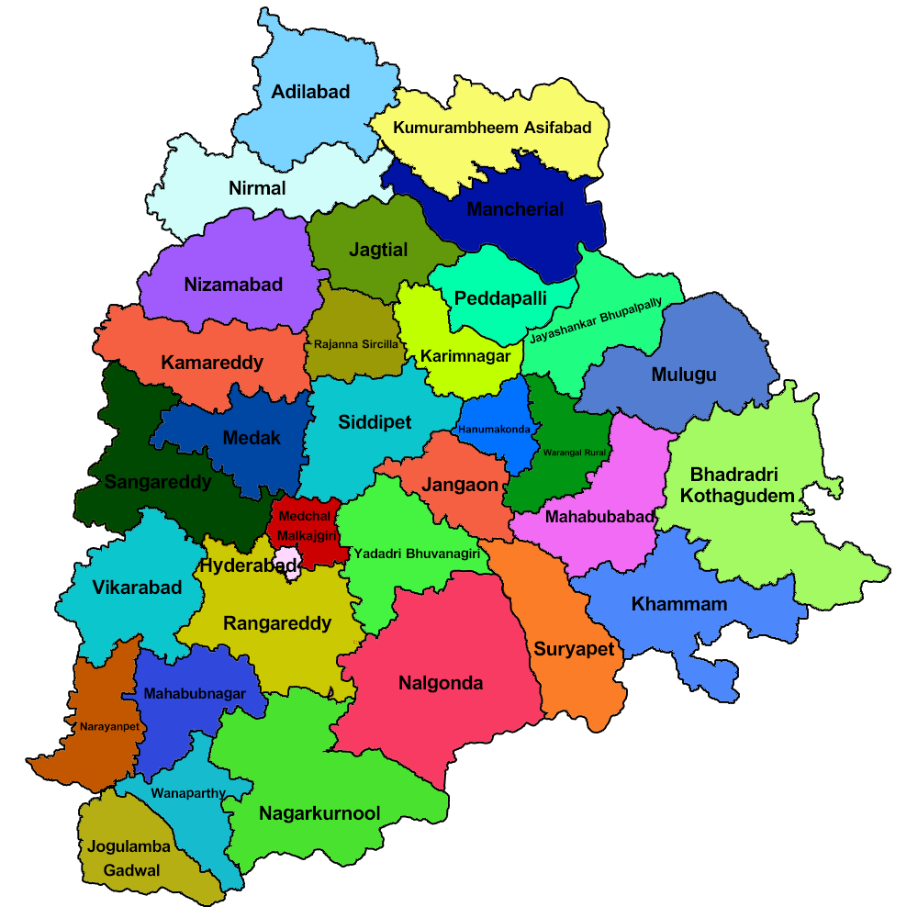
ABOUT TELANGANA
Formed as the 29th State of India, Telangana came into being on the 2nd of June, 2014.
The State has an area of 1,12,077 sq. Km. and has a population of 3,50,03,674 (2011 Census).
The Telangana region was part of the Hyderabad state from 17th September 1948 to 1st November 1956, until it was merged with Andhra State to form Andhra Pradesh.
Telangana is surrounded by Maharashtra and Chhattisgarh in the North, Karnataka in the West and Andhra Pradesh in the South and East directions.
Major cities of the State include Hyderabad, Warangal, Nizamabad, Nalgonda, Khammam and Karimnagar.

Slide 3
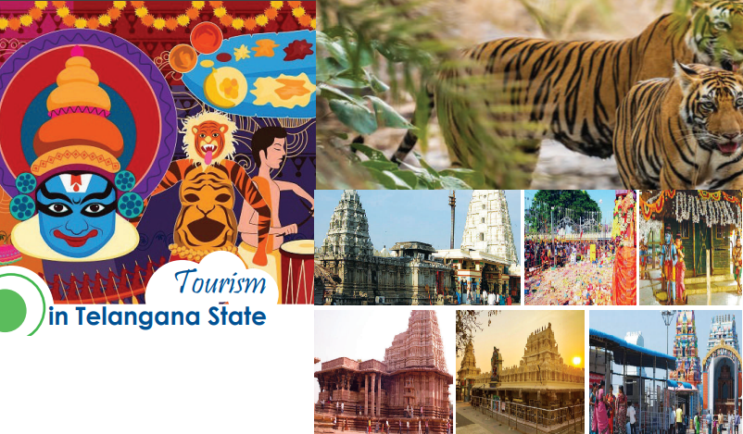
ABOUT TOURISM INDUSTRY
Tourism sector is economically important for any country and state. Apart from generating employment opportunities it considered as significant contributor of GDP and development of that country.
As a country, India has been consistently working on boosting its tourism sector by various campaigns and projects and as a result we have seen a significant growth and revenue generation from Tourism sector. This has immensely helped Telangana as well.
Telangana region has a rich cultural heritage and is known for its rich history, architecture and culture. This region has all required qualities for emerging as a potent tourist destination in India
The growth of the tourism sector in any State is highly dependent on tourism amenities. Therefore, the government has a critical role to play in developing basic infrastructure. At present most of the tourists arrival in the Telangana State is confined to Hyderabad, the state capital, and some pilgrim centres.
Let’s try evaluate the tourism growth of Telangana.

Slide 4
PRIMARY RESEARCH QUESTIONS

Slide 5
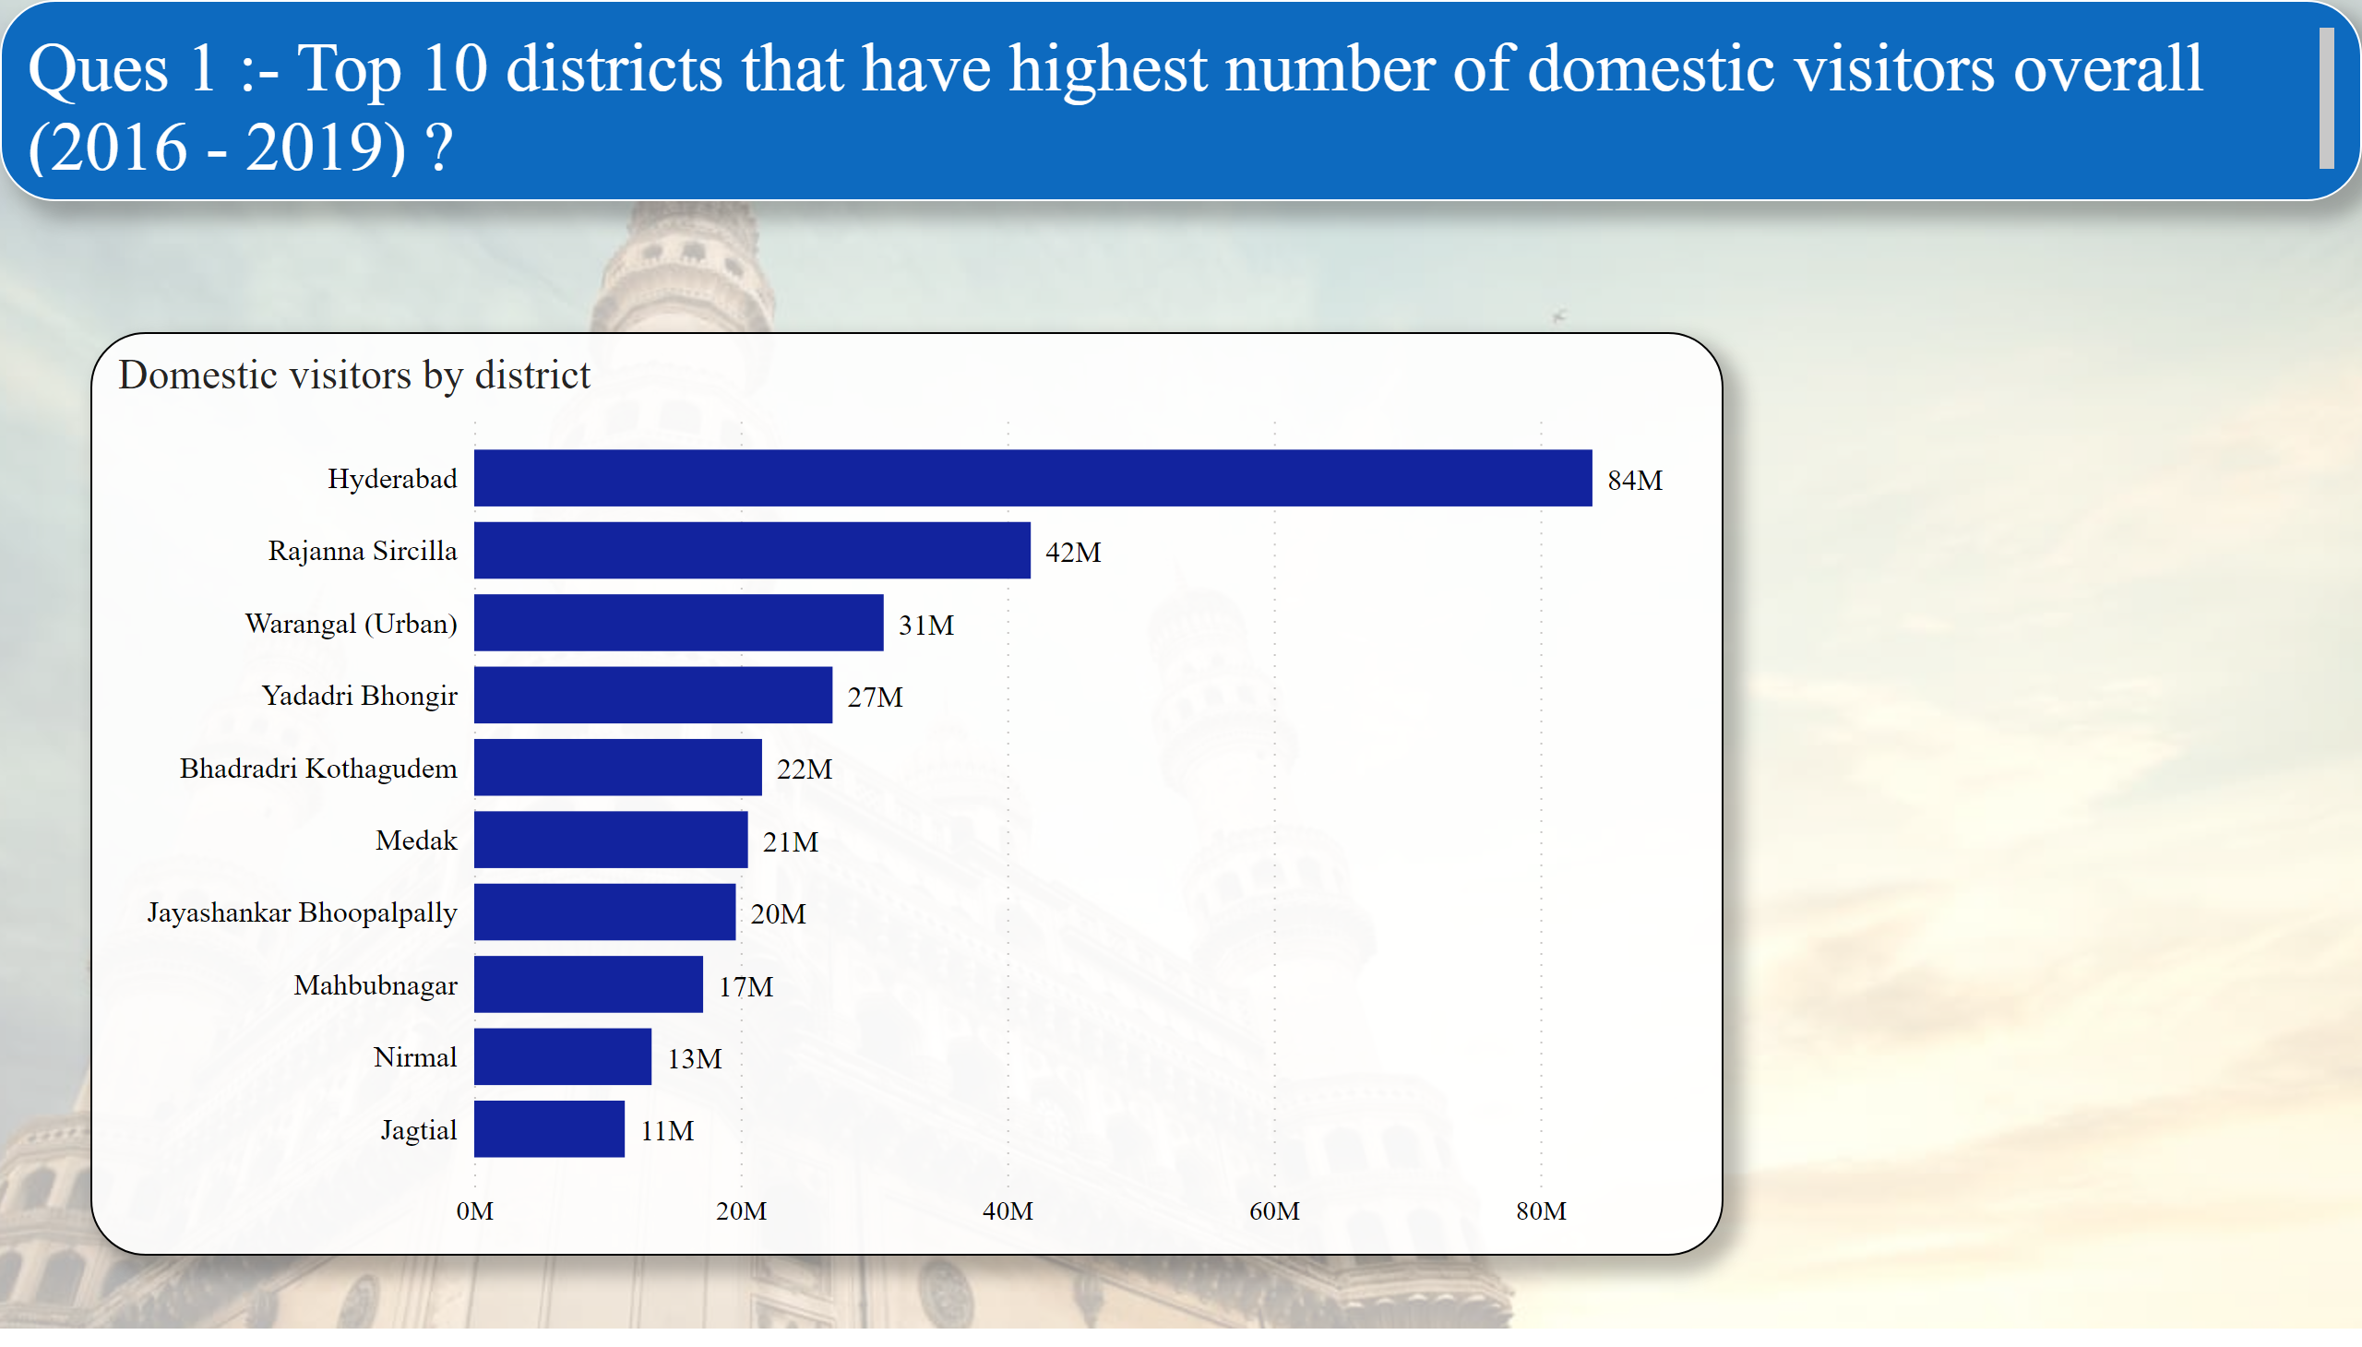
Page 2
Insights :- Hyderabad , Rajanna Sircilla , Warangal(Urban) , Yadari Bhongir , Bhadradri Kothagudem and Medak are Among top 5 districts with maximum number of domestic visitors.
Notes:
textbox
No alt text provided
Domestic visitors by district
No alt text provided

Slide 6
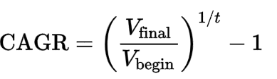
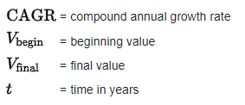
What is CAGR ?
CAGR stands for the Compound Annual Growth Rate. It is the measure of an investment's annual growth rate over time, with the effect of compounding taken into account.
It is often used to measure and compare the past performance of investments or to project their expected future returns. In this case we will use CAGR to see the growth in number of domestic and foreign visitors in the state and in different cities.
Formula for CAGR is
where

Slide 7
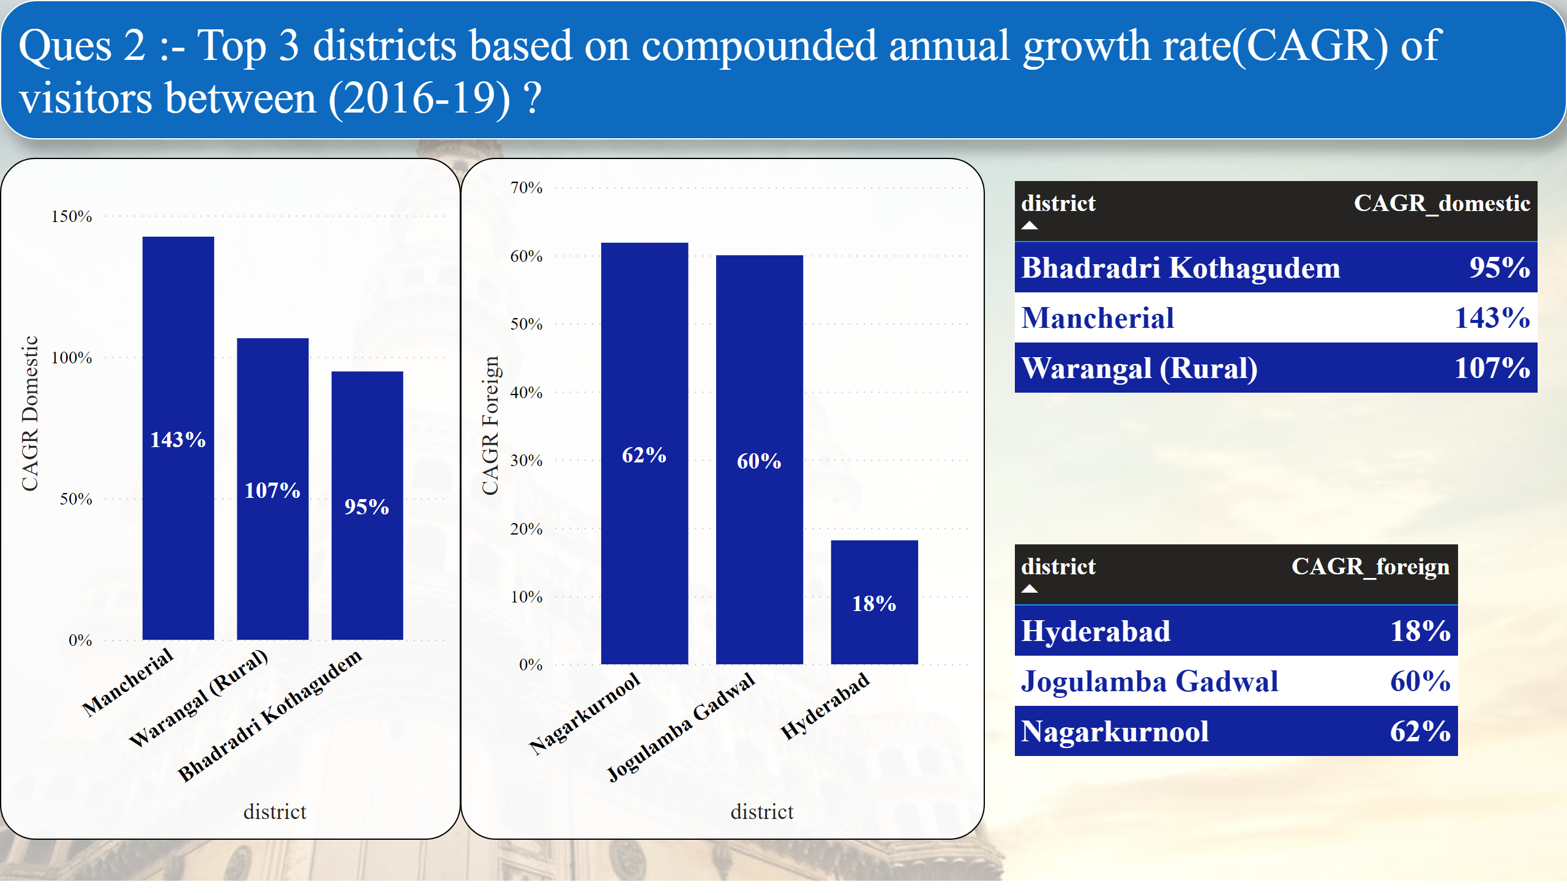
Page 3
Notes:
textbox
No alt text provided
columnChart
No alt text provided
columnChart
No alt text provided
Bottom 3 Districts by Domestic CAGR
No alt text provided
Bottom 3 Districts by Foreign CAGR
No alt text provided

Slide 8
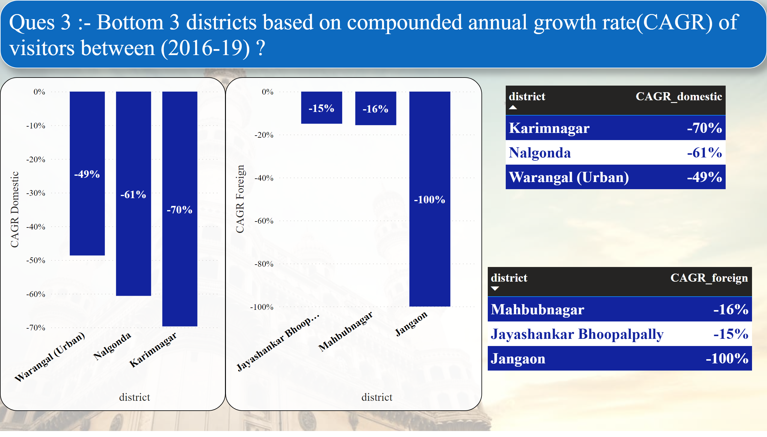
Page 4
Notes:
textbox
No alt text provided
columnChart
No alt text provided
columnChart
No alt text provided
Bottom 3 Districts by Domestic CAGR
No alt text provided
Bottom 3 Districts by Foreign CAGR
No alt text provided

Slide 9
Insights
Mancherial, Warangal(Rural) , Bhadradri Kothagudem are the top three districts with highest Domestic CAGR growth from Year 2016 to 2019 with respective value that are 143% , 107% and 95%.
While talking of Foreign CAGR growth , top 3 districts are Nagarkurnool, Jogulamba Gadwal and Hyderabad with respective Foreign CAGR growth percentage value as 62% , 60% and 18%.
Karimnagar, Nalgonda and Warangal(Urban) are the bottom three districts with lowest Domestic CAGR growth from Year 2016 to 2019 with respective value that are -70% , -61% and -49%.
While talking of Foreign CAGR growth , bottom 3 districts are Mahbubnagar, Jayashankar Bhoopalpally and Jangaon with respective Foreign CAGR growth percentage value as -16% , -15% and -100%.

Slide 10
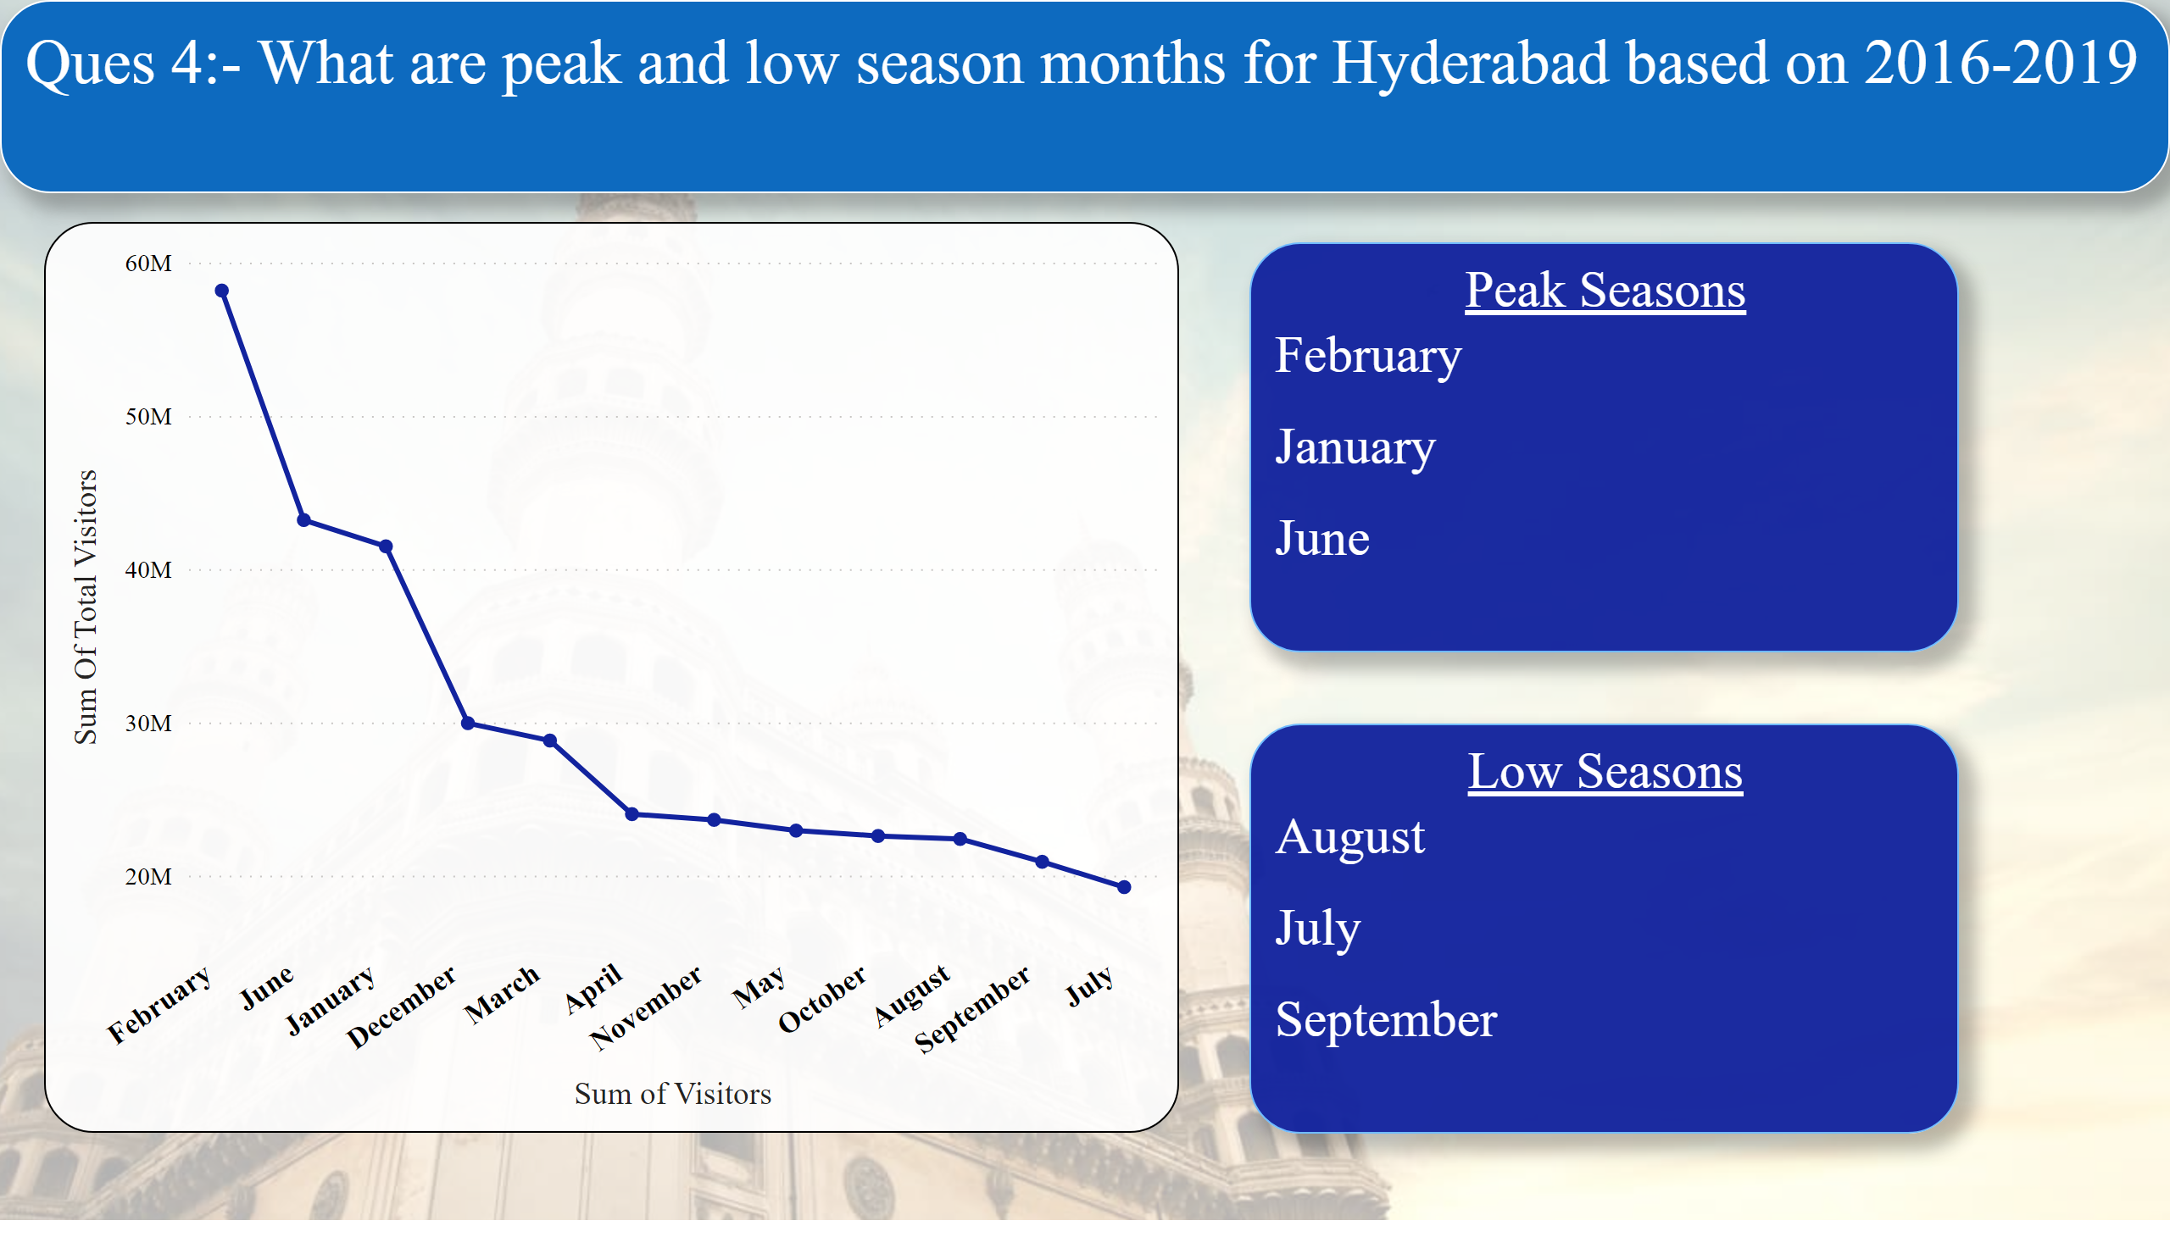
Page 5
Insights
Notes:
textbox
No alt text provided
lineChart
No alt text provided
Peak Seasons
No alt text provided
Low Seasons
No alt text provided

Slide 11
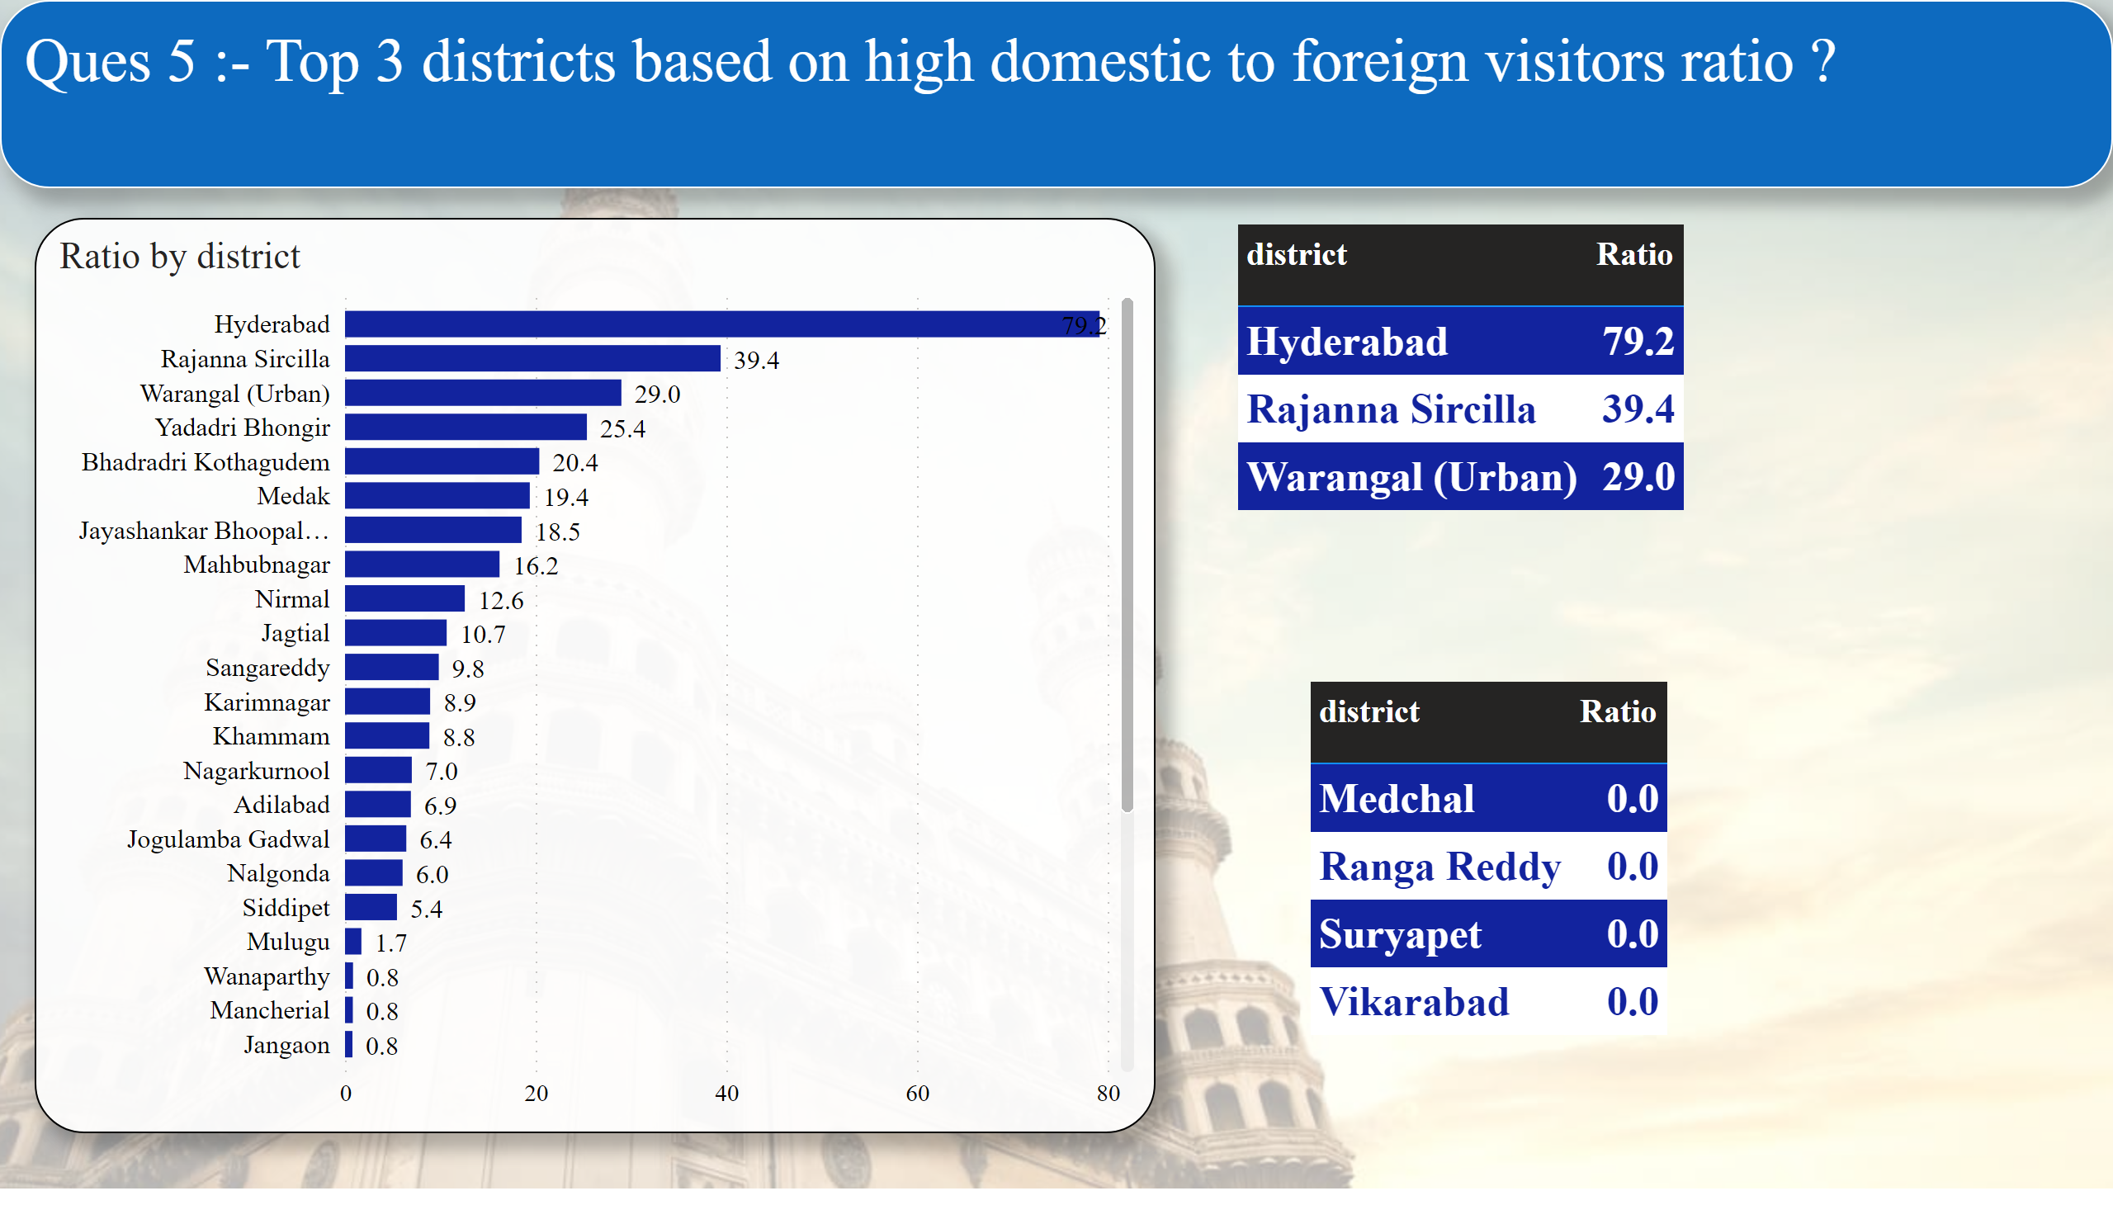
Page 6
Insights
Hyderabad , Rajanna Sircilla , Warangal (Urban) are the top 3 districts with highest Domestic visitors to Foreign visitors Ratio.
Whereas , districts like Medchal , Ranga Reddy , Suryapet and Vikarabad have value near to zero.
Notes:
textbox
No alt text provided
barChart
No alt text provided
Peak Seasons
No alt text provided
Low Seasons
No alt text provided

Slide 12
SECONDARY RESEARCH QUESTIONS

Slide 13
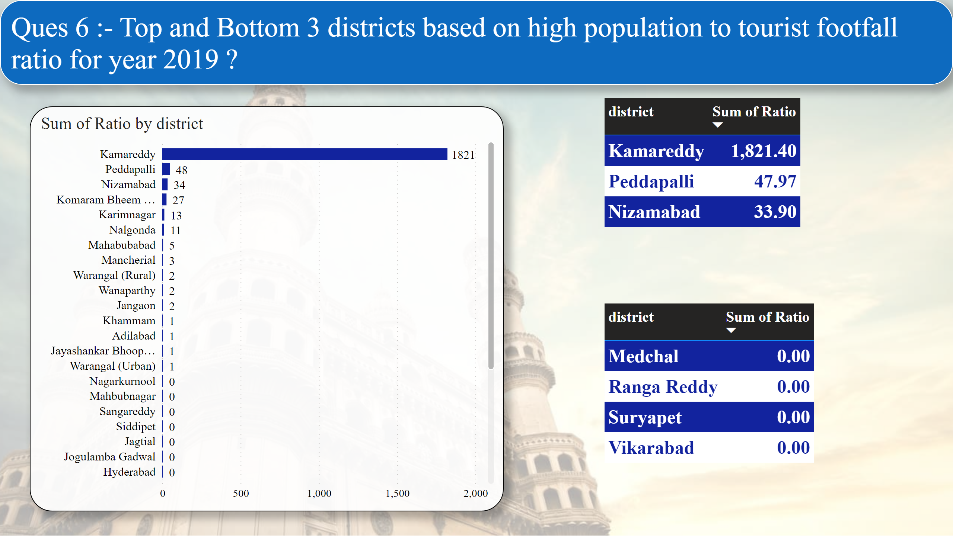
Page 7
Insights
Population to tourist ratio has revealed that Kamareddy is the district with highest ratio with 1821.0 followed by Peddapalli and Nizamabad with respective value 49.97 and 33.90. While districts like Medachal , Ranga Reddy have 0 value
Notes:
textbox
No alt text provided
barChart
No alt text provided
tableEx
No alt text provided
tableEx
No alt text provided

Slide 14
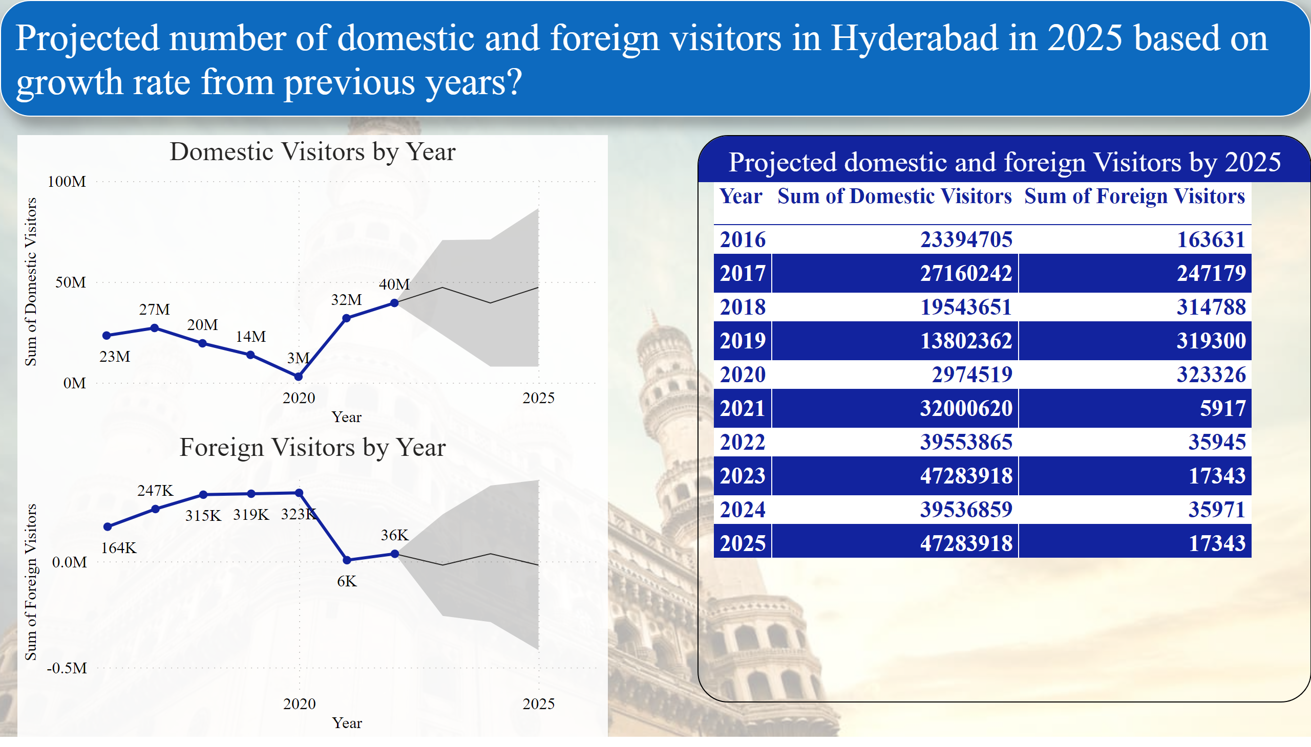
Page 9
Notes:
textbox
No alt text provided
Domestic Visitors by Year
No alt text provided
Foreign Visitors by Year
No alt text provided
Projected domestic and foreign Visitors by 2025
No alt text provided

Slide 15
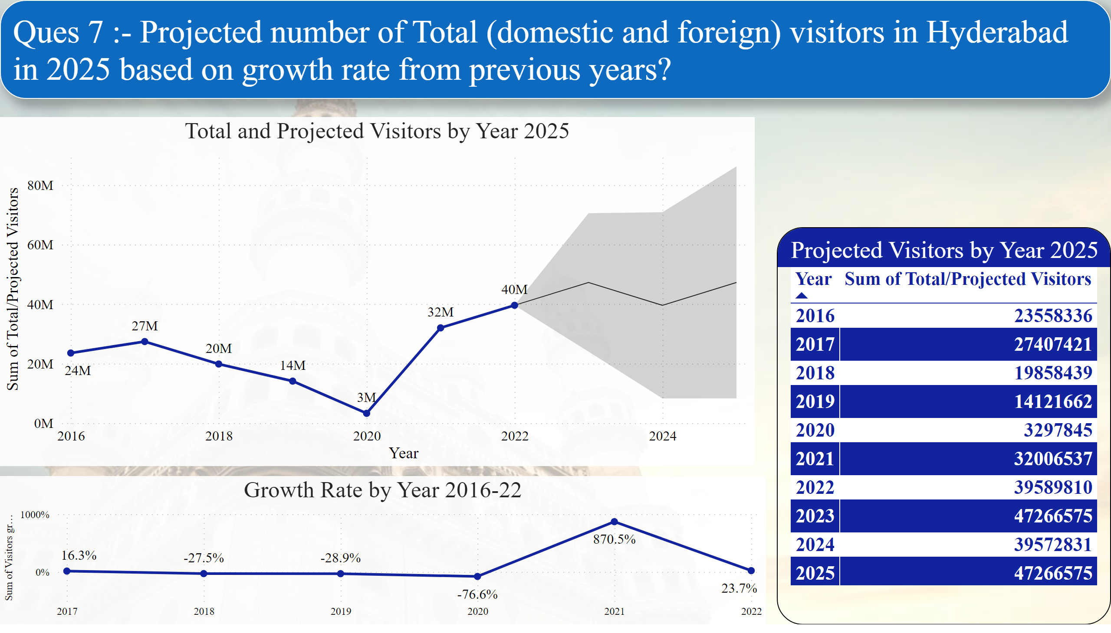
Page 8
Notes:
textbox
No alt text provided
Total and Projected Visitors by Year 2025
No alt text provided
Growth Rate by Year 2016-22
No alt text provided
Projected Visitors by Year 2025
No alt text provided

Slide 16
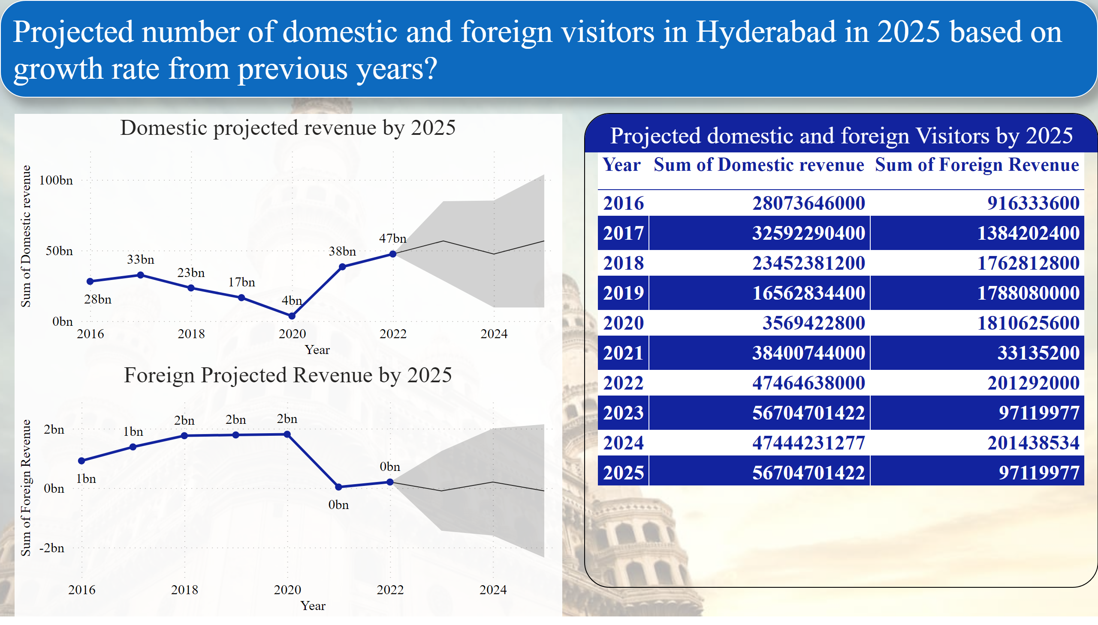
Page 11
Tourist | Average Revenue spent(in Rs)
Domestic | 1200
Foreign | 5600
Notes:
textbox
No alt text provided
Domestic projected revenue by 2025
No alt text provided
Projected domestic and foreign Visitors by 2025
No alt text provided
Foreign Projected Revenue by 2025
No alt text provided

Slide 17
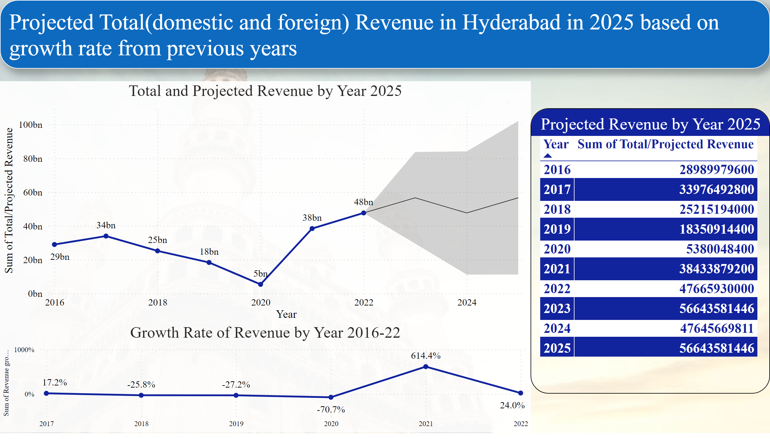
Page 10
Notes:
textbox
No alt text provided
Total and Projected Revenue by Year 2025
No alt text provided
Growth Rate of Revenue by Year 2016-22
No alt text provided
Projected Revenue by Year 2025
No alt text provided

Slide 18
Insights
I have used the data provided for years 2016 to 2019 along with data found online for years 2020, 2021, and 2022 to forecast the data for years 2023, 2024, and 2025 using PowerBI's forecast tool.
Based on research and data , it is predicted that Hyderabad will see increase in its total number of visitors ( domestic plus foreign visitors) . Value will increase to nearly 47 Million from 39 Million. This trend will first increase, then decline, and then resume increasing.
There would undoubtedly be an increase in tourists visiting Hyderabad as a whole.

Slide 19
RECOMMENDATIONS TO GOVERNMENT

Slide 20
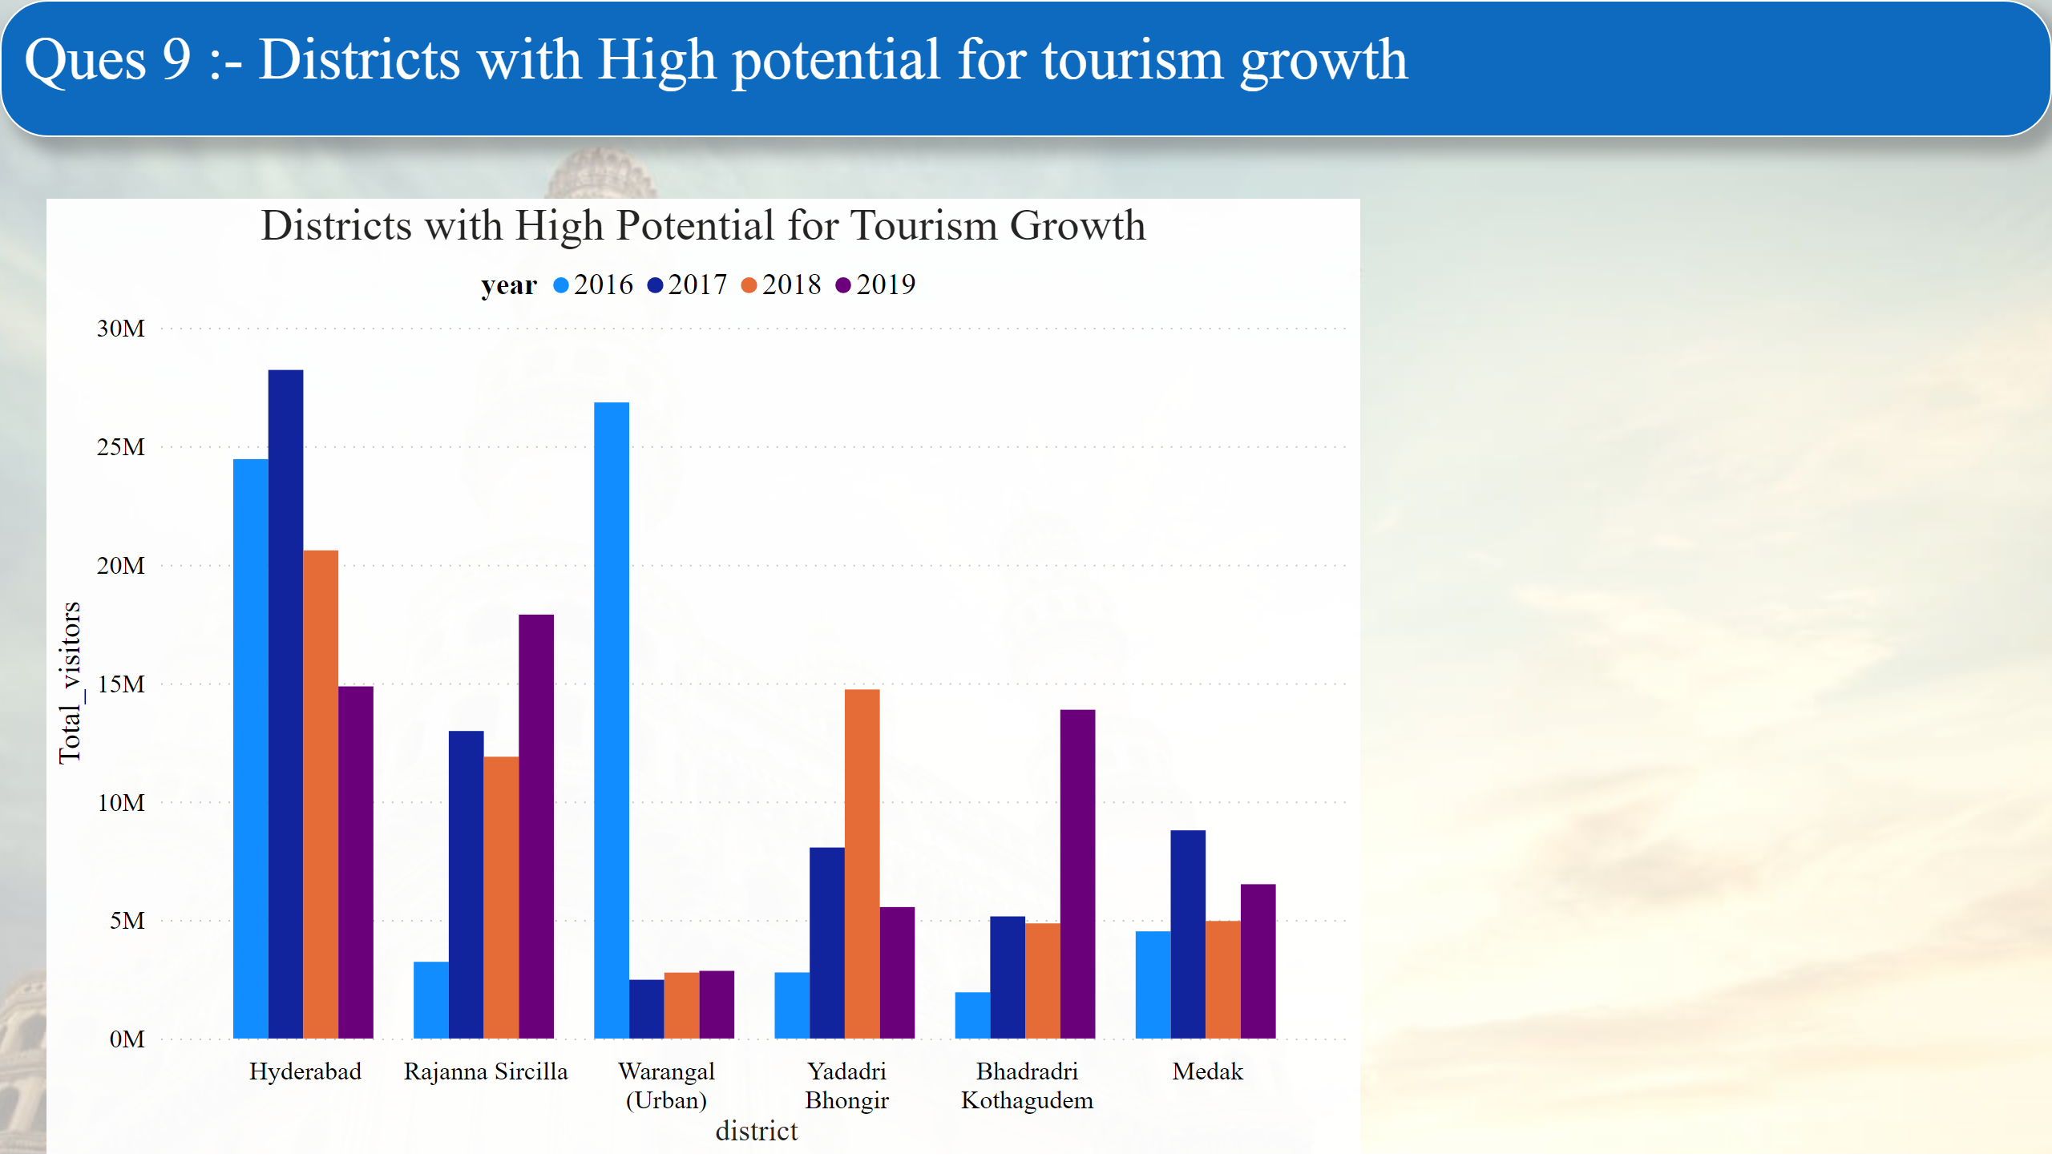
Page 12
Insights
Hyderabad
Rajanna Sircilla
Warangal(Urban)
Yadadri Bhongir
Bhadradri Kothagudem
Medak
These are the top 5 districts that have constantly been visited by large number of both domestic and foreign visitors. Hence, government should focus on implementing growth and market strategies in these districts initially and then to others.
Notes:
textbox
No alt text provided
Districts with High Potential for Tourism Growth
No alt text provided

Slide 21
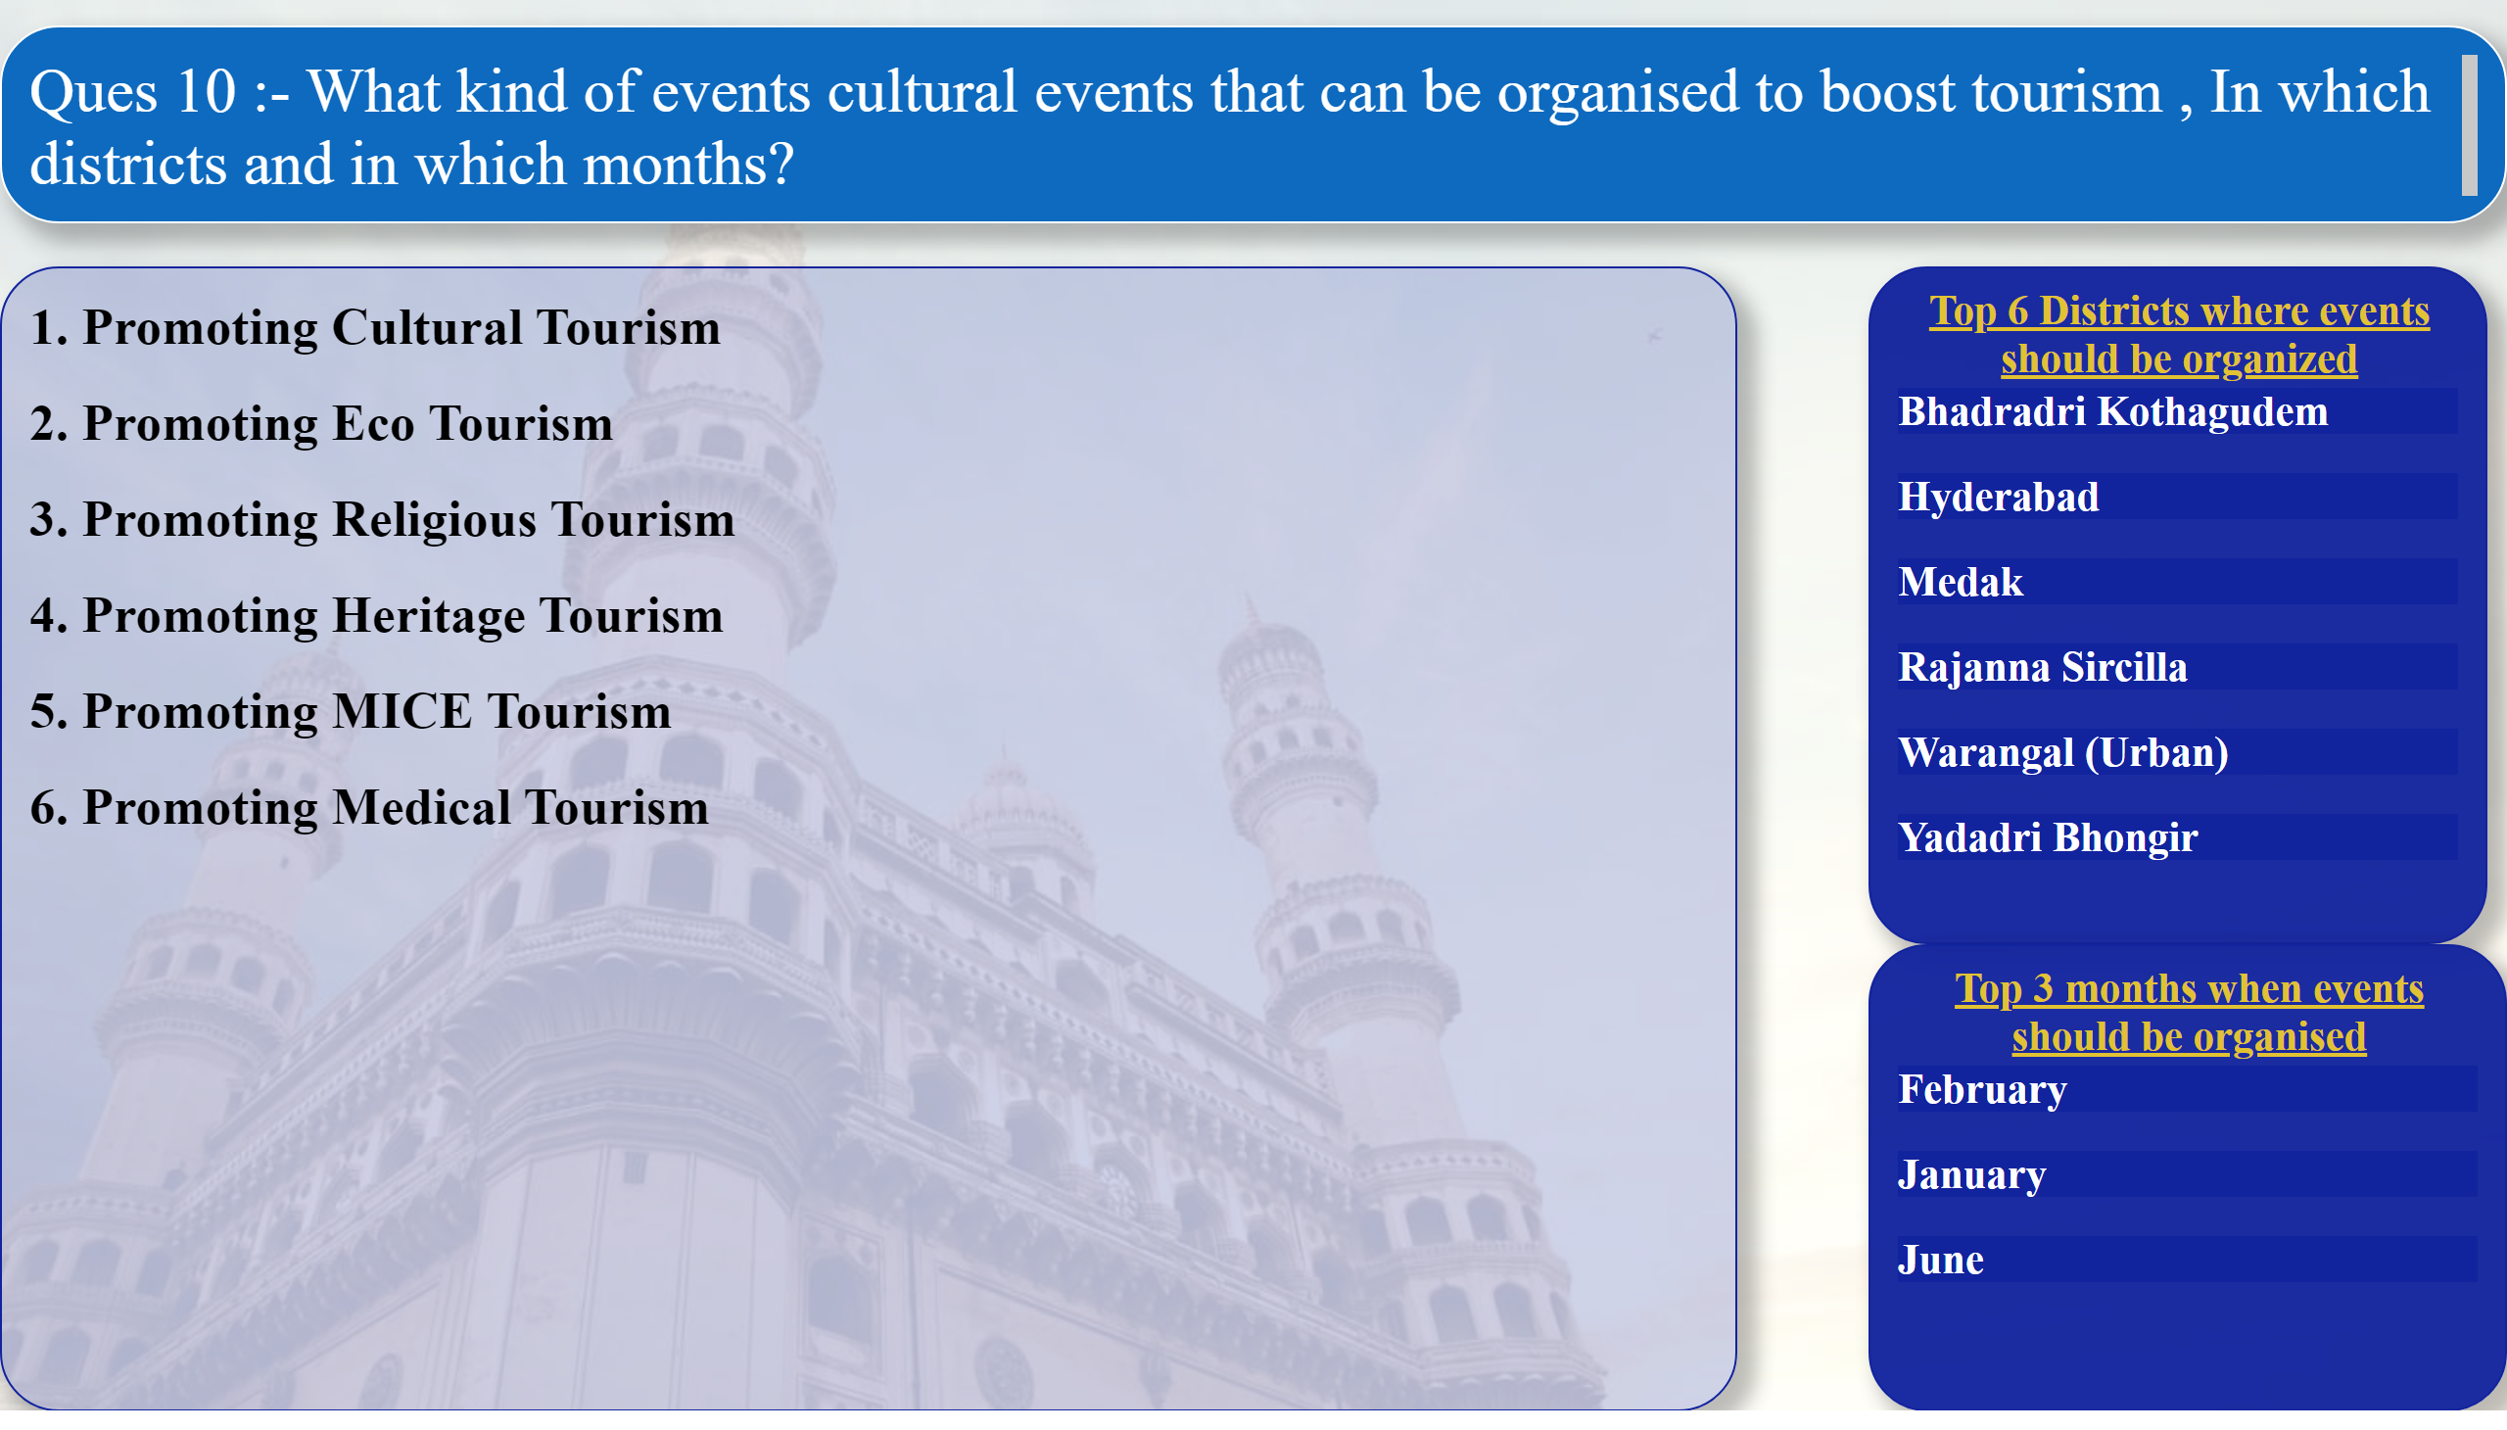
Page 13
Activities and cultural Events that can be performed to boost tourism :-
Large scale state festivals like Bonalu, Bathamukamma, International kite festival etc. can be planned.
Handicraft Exhibition to boost state’s fantastic handicrafts, including bronze casting, Dokra metalwork, Bidri craft, and banjara needlework. These handicrafts have great international value and demand.
Organizing food festivals to showcase its unique and authentic food that is a unique blend of cuisines, beverages and eating habits.
MICE – It stands for Meetings, Incentives, Conferencing, Exhibitions. The state offers the best international connectivity and facilities and has grown into a world class Meetings, Incentives, Conventions and Exhibitions destination.
Tribal music and dance – As part of its rich culture the music and dance forms of Telangana are performed with great enthusiasm all over the state. These folk dances that make Telangana unique are – Gussadi dance, Dhimsa dance, Lambadi dance etc.
Notes:
textbox
No alt text provided
textbox
No alt text provided
Top 6 Districts where events should be organized
No alt text provided
Top 3 months when events should be organised
No alt text provided

Slide 22
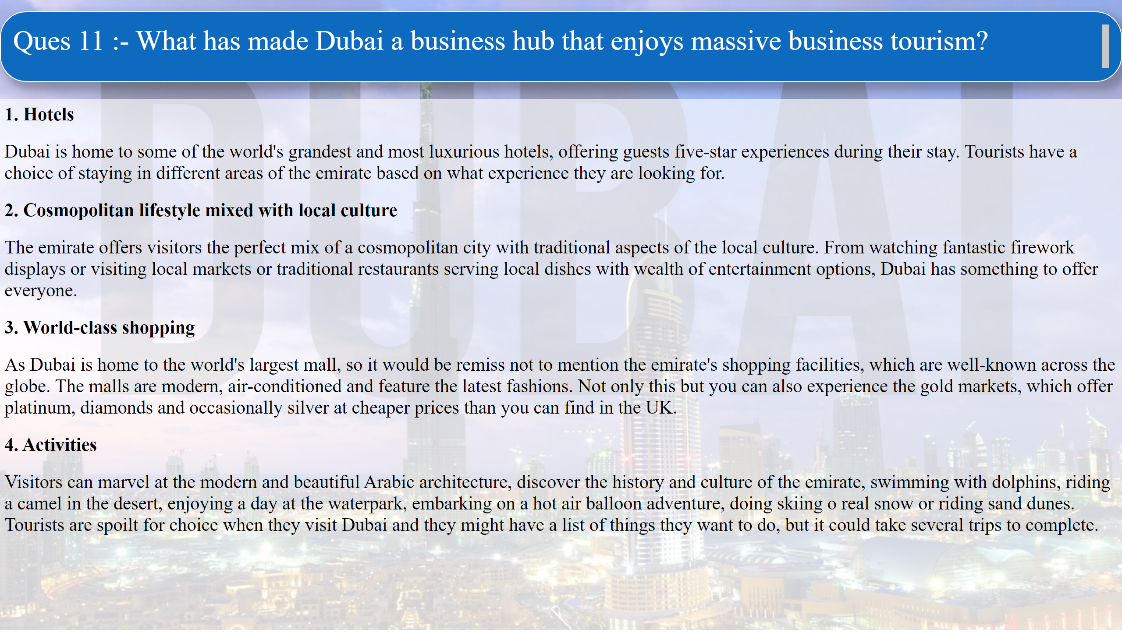
Page 14
Notes:
textbox
No alt text provided
textbox
No alt text provided

Slide 23
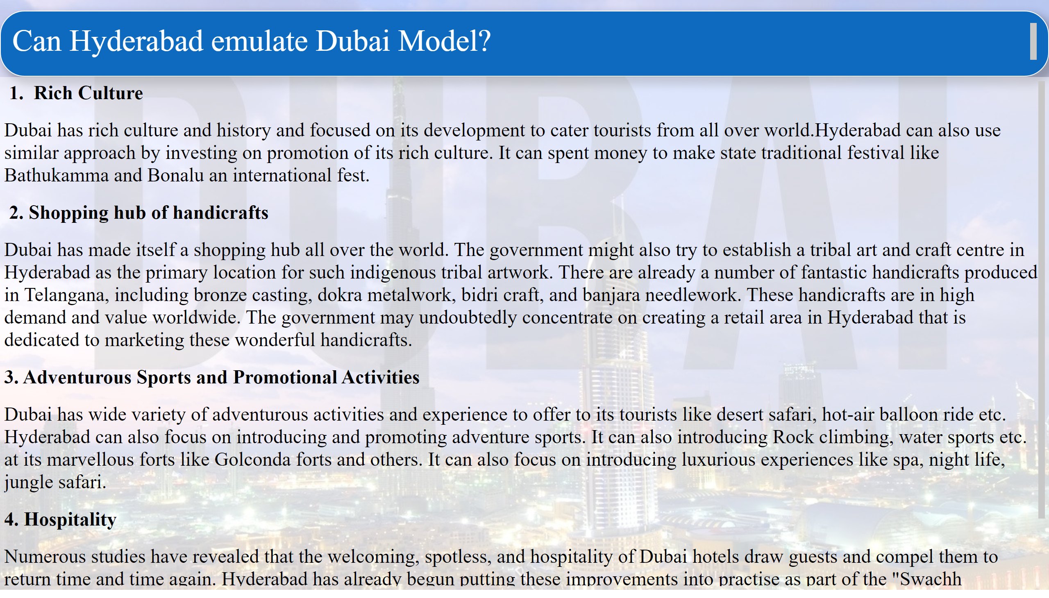
Page 15
Notes:
textbox
No alt text provided
textbox
No alt text provided

Slide 24
Provide recommendations that can boost tourism in Telangana
Creation of amenities
This will make city more welcoming and alluring to tourists. The government may take into account adding more amenities for visitors as part of the "Swachh Hyderbad" programme to improve their vacation experience. This may include fostering basic hygiene or establishing a 24x7 helpdesk units in places to help foreign visitors
2. Tourism is not just Sightseeing Spots
Tourism should not be promoted as just sightseeing spots; they need to be promoted as “destination experiences”. Steps should be taken to make the tour replete with guides, activities for the children, interactivity for the tourists with culture of the place, organizing cultural activities (dances and other art forms) culinary points etc. These activities leave the tourists with the experience of involvement and give them urge to visit the place again and again.
3. Bringing the Arts and Crafts of Telangana into Limelight
Telangana is a land of variety of arts mostly confined to villages and rural areas. There need to be a specific campaign of promotion for bringing the arts and crafts of Telangana into limelight. Introducing ‘Rural Packages’ and present to the World the arts and crafts will not only create visibility and business for tourism sector but will also have visibility impact for the State of Telangana.
4. Building Infrastructure like great roads and access points.
5. Online and offline marketing strategies

Slide 25
Provide recommendations that can boost tourism in Hyderabad
Focusing on Culture and Heritage
Hyderabad famously known as ‘City of Nawabs’ is famous for its marvellous and opulent architecture. Various forts and attract tourists worldwide. Government can organize festivals to celebrate its architecture to cater tourists. Food festivals can also held to promote the authentic hyderabadi taste and cuisines.
2. Skill Development for MICE Industry
Hyderabad has emerged as most attractive destination for MICE tourism and setting up of skill centre for human resource development for MICE industry will create large number of jobs in the state. Specialised training programs to provide skills at entry level management in handling MICE activity can make huge positive impact on the growth.
Promoting Medical Tourism
Hyderabad is among the top 5 cities in the country that attracts the international tourists maximum for cheaper and quality medical treatments. Hyderabad offers world class treatment in the fields of heart surgeries, joint replacements, brain and spine surgery using robots etc. at the costs lower by at least 60 - 80% compared to similar procedure in the US and UK. Quality in Healthcare (JCI accredited hospitals) and highly trained doctors / surgeons is something that catered the revenue of nearly Rs 15 crore in 2018 and is projected to grow nearly by Rs 50 crore in next 10 years. Government can focus on building growth strategies for medical tourism.

Slide 26
Data Sources
https://www.livemint.com/news/india/telangana-aims-for-20-30-pc-rise-tourist-influx-by-the-end-of-2023-11669571322890.html
https://tourism.gov.in/sites/default/files/2022-09/India%20Tourism%20Statistics%202021%20%281%29.pdf
https://tourism.gov.in/sites/default/files/2022-09/India%20Tourism%20Statistics%202021%20%281%29.pdf
https://www.discoverherveybay.com/what-makes-tourism-in-dubai-so-much-better/#:~:text=Dubai%20Has%20The%20Most%20Luxurious%20Hotels&text=and%20it%20is%20also%20the,What%20is%20this%3F
https://www.telangana.gov.in/about/state-profile
https://www.telangana.gov.in/about/state-profile

Slide 27
THANK YOU

